Slide 1
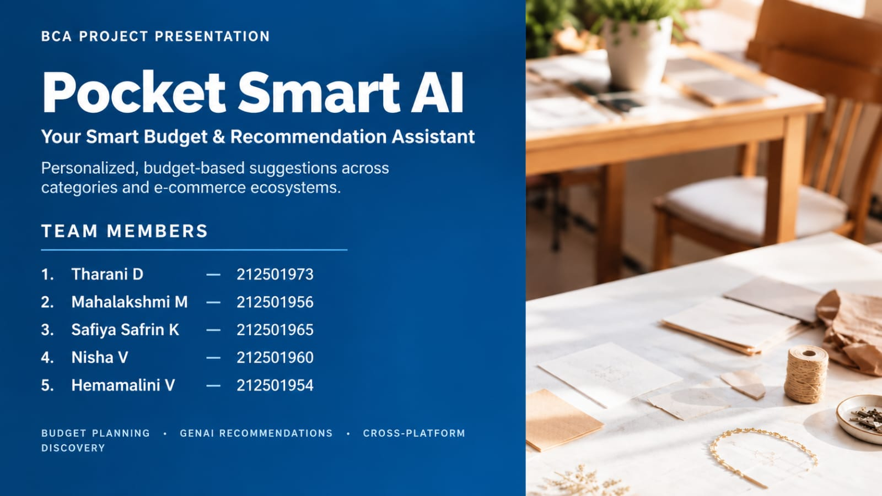
BCA PROJECT PRESENTATION
Pocket Smart AI
Your Smart Budget & Recommendation Assistant
Personalized, budget-based suggestions across categories and e-commerce ecosystems.
BUDGET PLANNING · GENAI RECOMMENDATIONS · CROSS-PLATFORM DISCOVERY

Slide 2
PROJECT INTRODUCTION
POCKETSMART AI
Personalized recommendations, grounded in a budget
01
A GenAI-powered assistant for decisions across home decor, events, and jewelry shopping.
POCKETSMART AI · BCA PROJECT PRESENTATION
02

Slide 3
01 / PROJECT INTRODUCTION
Budget planning becomes difficult when choices multiply
MANY CATEGORIES
MANY CHOICES
THE GOAL
Home decor, events, and jewelry
More options create more friction
Decide without overspending
Each spans many products, platforms, and price ranges.
Comparing products and services makes decisions harder.
Pocket Smart AI provides personalized, budget-based suggestions.
POCKETSMART AI ADDRESSES THIS WITH A GENAI-POWERED, CROSS-PLATFORM RECOMMENDATION SYSTEM.
POCKETSMART AI · BCA PROJECT PRESENTATION
03

Slide 4

THE PLATFORM MODEL
Pocket Smart AI connects budgets, preferences, and platforms
Budgets
Gemini 1.5 Flash Pro interprets user budgets, preferences, context, and optional images.
Adaptive forms and a recommendation engine bridge multiple categories and e-commerce ecosystems.
Set spending limits and ranges
Preferences
Style, brands, and delivery options
PocketSmart AI
Recommendation engine hub connecting inputs to platforms
RECOMMENDATIONS CAN SPAN AMAZON, FLIPKART, IKEA, SWIGGY, ZOMATO, OYO, AND MORE.
Optional Images
Upload photos for visual matching
Platforms
Amazon, Flipkart, IKEA, Swiggy, Zomato, OYO
POCKETSMART AI · BCA PROJECT PRESENTATION
04

Slide 5



ONE PLATFORM · THREE ASSISTANTS
Three planners turn one platform into three practical assistants
HOME INTERIOR PLANNER
PARTY PLANNER
JEWELRY PLANNER
Room-aware decor recommendations
Budget allocation by need
Occasion- and style-aware suggestions
Plans catering, decoration, entertainment, and accommodation.
Balances style, function, and price.
Supports optional outfit image analysis.
EACH PLANNER CONVERTS STRUCTURED INPUTS INTO TAILORED RECOMMENDATIONS.
POCKETSMART AI · BCA PROJECT PRESENTATION
05

Slide 6
PLANNER 01
Home Interior Planner balances style, function, and price
01
02
03
04
Select
Define room
Set quantities
Recommend
User selects the Home Budget Planner and enters a budget.
Room types can include Living Room, Kitchen, and Bedroom.
Specify quantities for lights, ceiling fans, dining tables, and other items.
Gemini processes inputs and recommends cost-effective options across IKEA and Amazon.
POCKETSMART AI · BCA PROJECT PRESENTATION
06

Slide 7
PLANNER 02
Party Planner allocates the event budget by need
01
02
03
04
Capture context
Allocate
Discover
Match the event
Enter total budget, guest count, event type, and venue details.
AI allocates budget proportionally across catering, decoration, and entertainment.
Suggestions can draw from Swiggy, Zomato, and accommodation services such as OYO.
Event context includes birthday, corporate, and wedding scenarios.
POCKETSMART AI · BCA PROJECT PRESENTATION
07

Slide 8

PLANNER 03
Jewelry Planner adds multimodal styling support
User enters budget, occasion, and style preferences.
An outfit image can be uploaded optionally for color coordination and aesthetic analysis.
Gemini 1.5 Flash Pro returns jewelry options from platforms such as Amazon and Flipkart.
POCKETSMART AI · BCA PROJECT PRESENTATION
08

Slide 9
ARCHITECTURE AND TECHNOLOGY
POCKETSMART AI
From adaptive inputs to tailored recommendations
02
A modular platform connects the user interface, service layer, Gemini, and third-party sources.
POCKETSMART AI · BCA PROJECT PRESENTATION
09

Slide 10

02 / ARCHITECTURE AND TECHNOLOGY
A modular platform connects UI, backend, Gemini, and sources
FRONTEND
Collects budgets, preferences, and images.
Frontend
Backend
Collects budgets, preferences, and images
Flask/FastAPI routes, sessions, models, AI comms
SERVICE LAYER
Flask/Fast API backend manages routes, sessions, models, and AI communication.
AI AND SOURCES
Gemini 1.5
Third-Party
Processes text, numbers, and images
Provides product and service context
Gemini 1.5 Flash Pro processes text, numbers, and images; third-party platforms provide product and service context.
POCKETSMART AI · BCA PROJECT PRESENTATION
10

